Slide 1
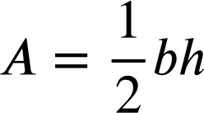
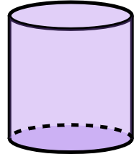
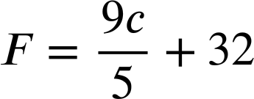
Changing the subject to suit the context
Task A: Rearranging additive and multiplicative steps
1) a) Rearrange the formula for circumference of a circle so that it would be more efficient for finding the radius if you knew the circumference.
C
C = 2πr
r
1) b) Rearrange the formula for area of a triangle so that it would be more efficient for finding the height if you knew the area and the base.
Height
Base
1) c) Rearrange the formula for surface area of a cylinder so that it would be more efficient for finding the height if you knew the surface area and radius.
r
A = 2πr² + 2πrh
h
2) This is the formula for converting Celsius into Fahrenheit.
Show two ways to rearrange the formula so that it converts Fahrenheit into Celsius.

Slide 2
Changing the subject to suit the context
Task B: Rearranging equations to find the gradient
1) Work out the gradient and the y-intercept of the lines given by these equations by rearranging to make y the subject.
a) x + 4y = 12
b) 2x + 6y = −18
c) 8x − 2y = 15
2) Rearrange this general form of a linear equation to make y the subject and find an expression for the gradient and y-intercept when in this form.
ax + by = c
Mathematics in Education and Industry
v2.3

